Slide 1

Building Web GIS for Visualizing India's Demographic Distribution at Pincode Level Course Instructor : Dr Salil Goel , Assistant Professor Course TAs: Digvijay Singh, PhD Shubhi Kant, PhD
Geographical Information System
CE 432 A
(15 April 2024)
Project Team
Anukul Dwivedi (Roll No 231030402)
Satyam Agnihotri (Roll No 231030406)

Slide 2
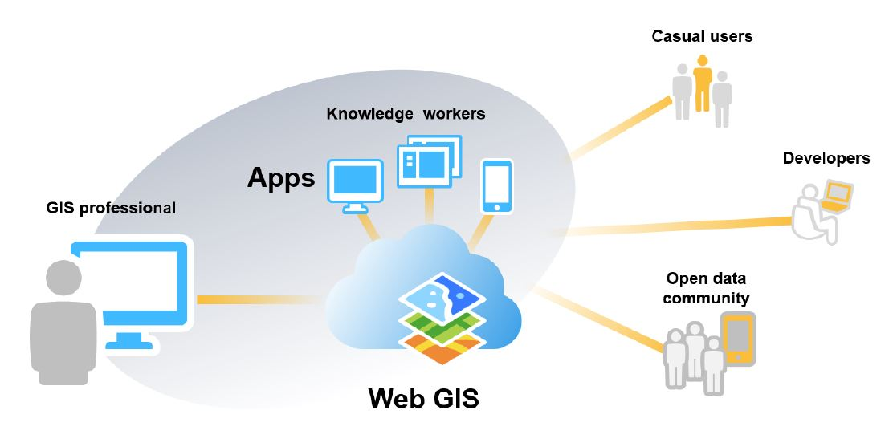
Introduction to Web GIS

Slide 3
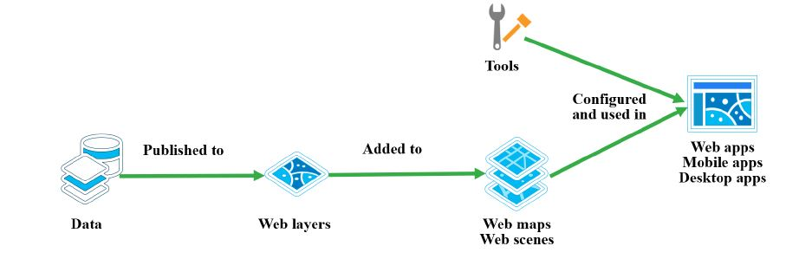
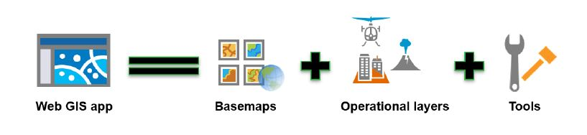
Components of WebGIS
Esri. (n.d.). Web GIS: Principles and Applications for GIS Web. Retrieved from https://www.esri.com/content/dam/esrisites/en-us/esri-press/pdfs/gtk-web-gis-5e-sample.pdf

Slide 4
Data Collection
Sources
Census Data From Government of India
PINCODE data from India Post
State and District shape file from Open Source
"Census of India.” (n.d.). Census Tables. Retrieved from https://censusindia.gov.in/census.website/data/census-tables"
"Esri. (n.d.). [Pincode Boundary of India 2022]. Retrieved from https://www.arcgis.com/home/item.html?id=e1e9c110611b4e3383a3169901576544"
Esri. (n.d.). Web GIS: Principles and Applications for GIS Web. Retrieved from https://www.esri.com/content/dam/esrisites/en-us/esri-press/pdfs/gtk-web-gis-5e-sample.pdf

Slide 5
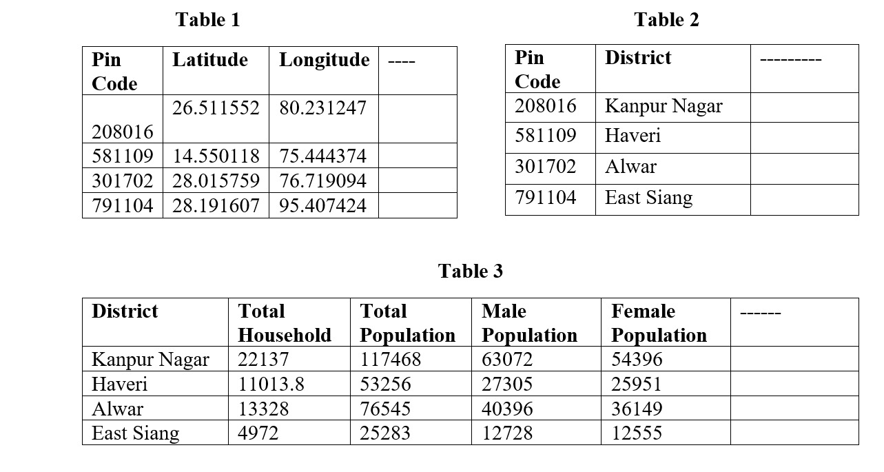
Data Standarisation and Integration

Slide 6
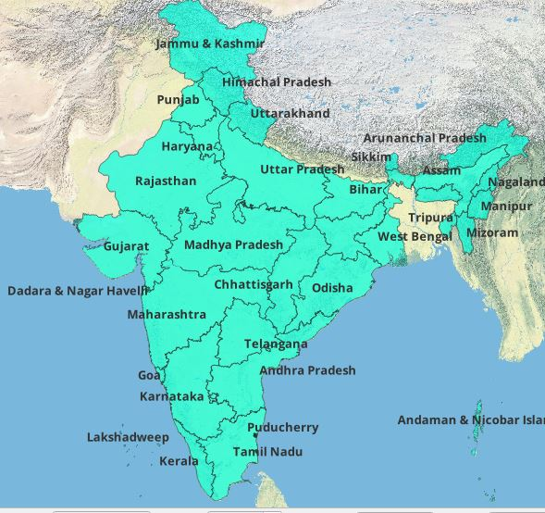
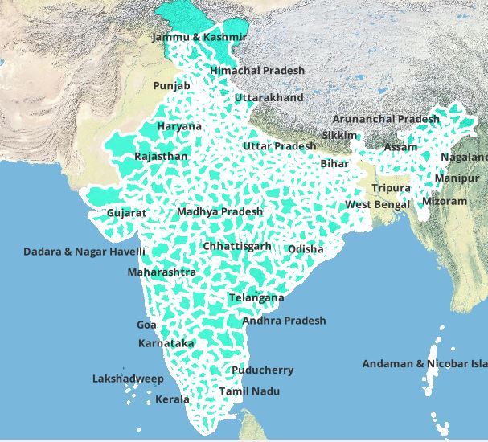
Creating Layers
State Boundary layer
District Boundary Layers

Slide 7
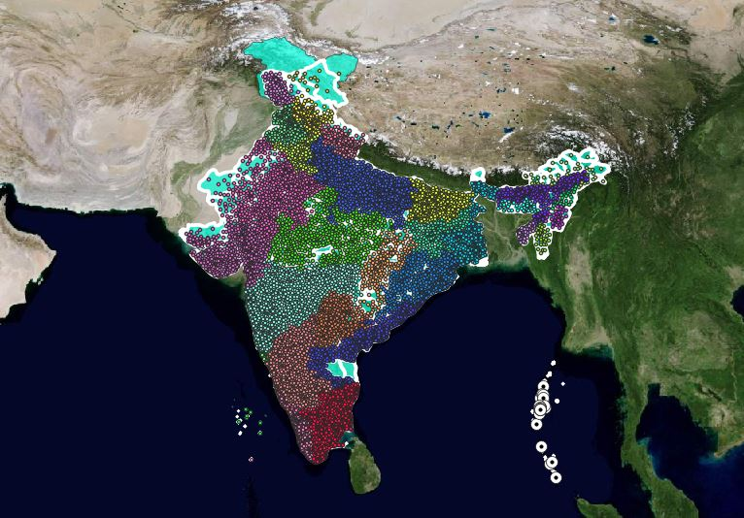
Pincode Distribution

Slide 8
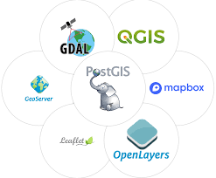
Developing WebGIS

Slide 9
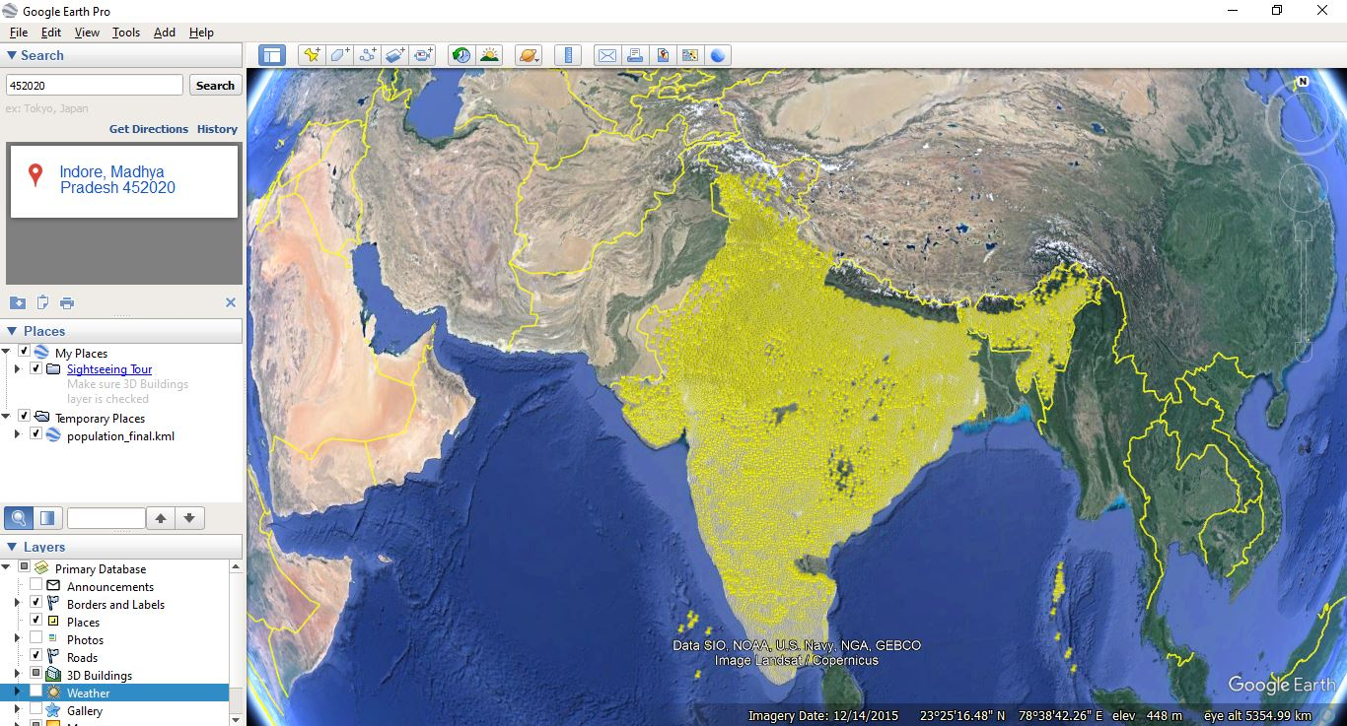
Pincodes on Google Earth Pro

Slide 10
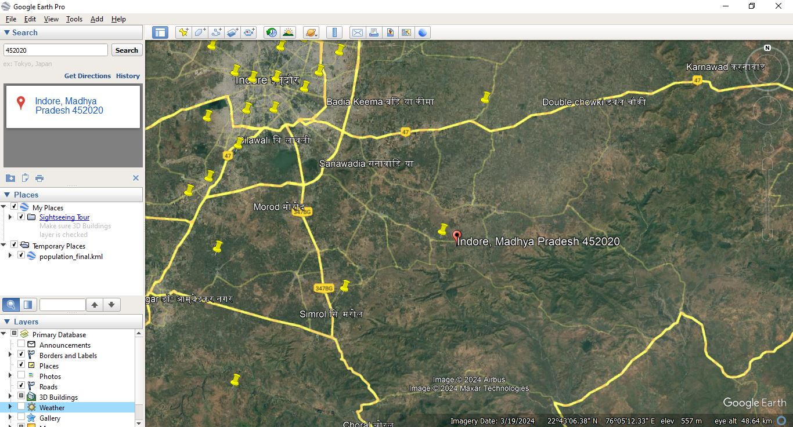
Accuracy Check

Slide 11
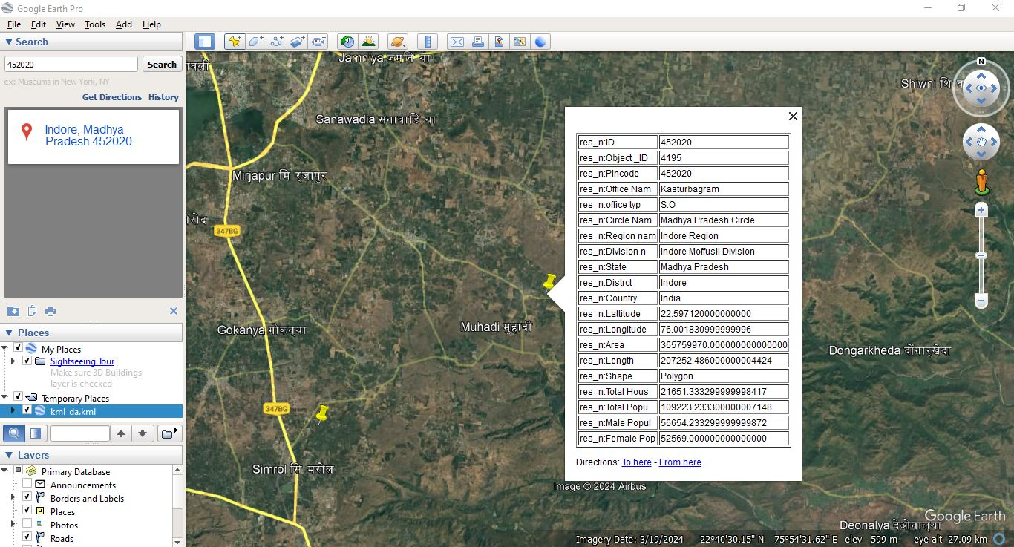
Population of INDIA with WebGIS
Nominal Altitude: 6096 m
Altitude for Analysis: 6629 m
No. of Crossover: 211

Slide 12
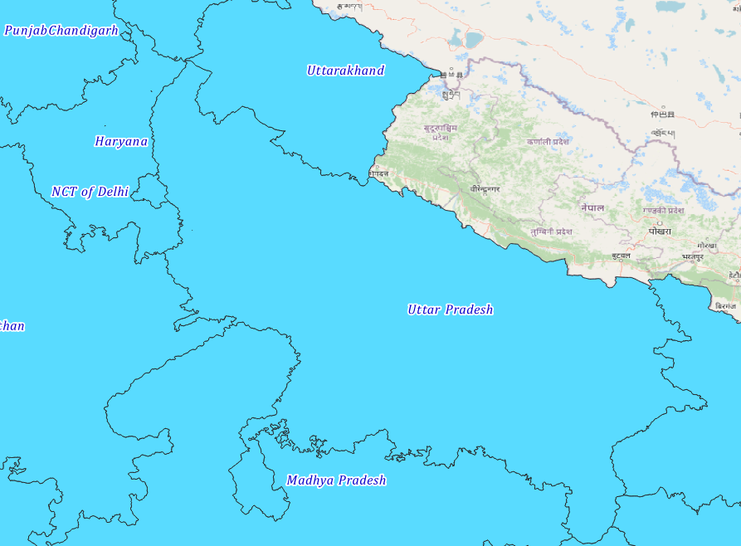
IIT Kanpur - 208016
Uttar Pradesh
India

Slide 13
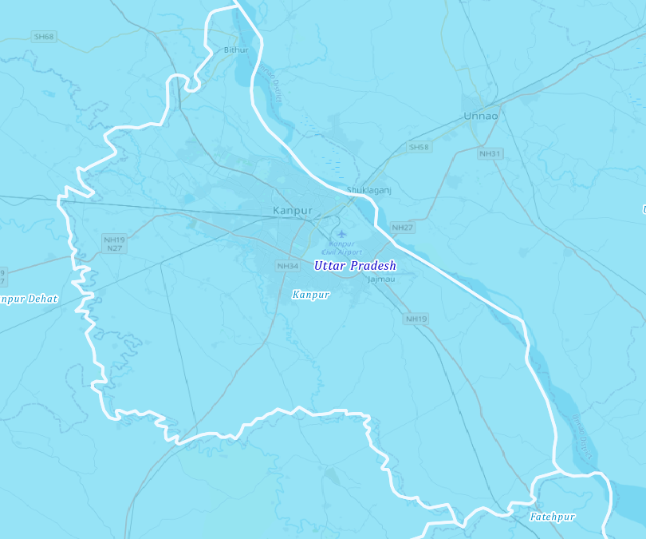
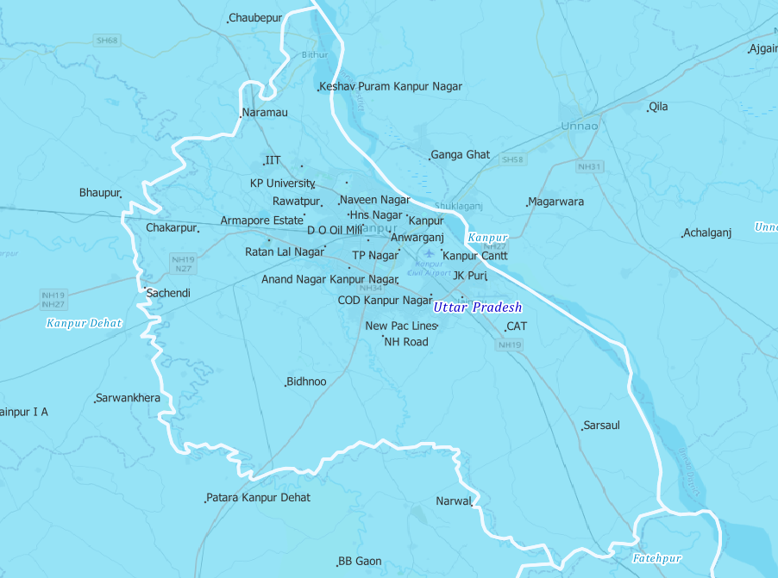
IIT Kanpur - 208016
Kanpur-District
Pincode Location

Slide 14
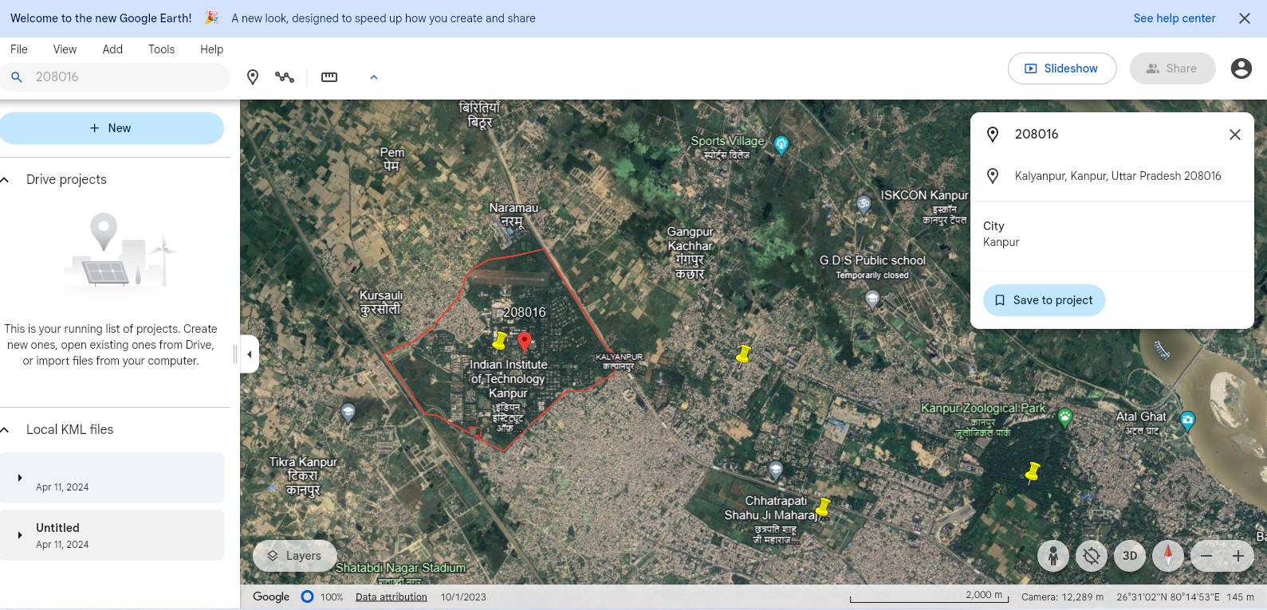
IIT Kanpur - 208016

Slide 15
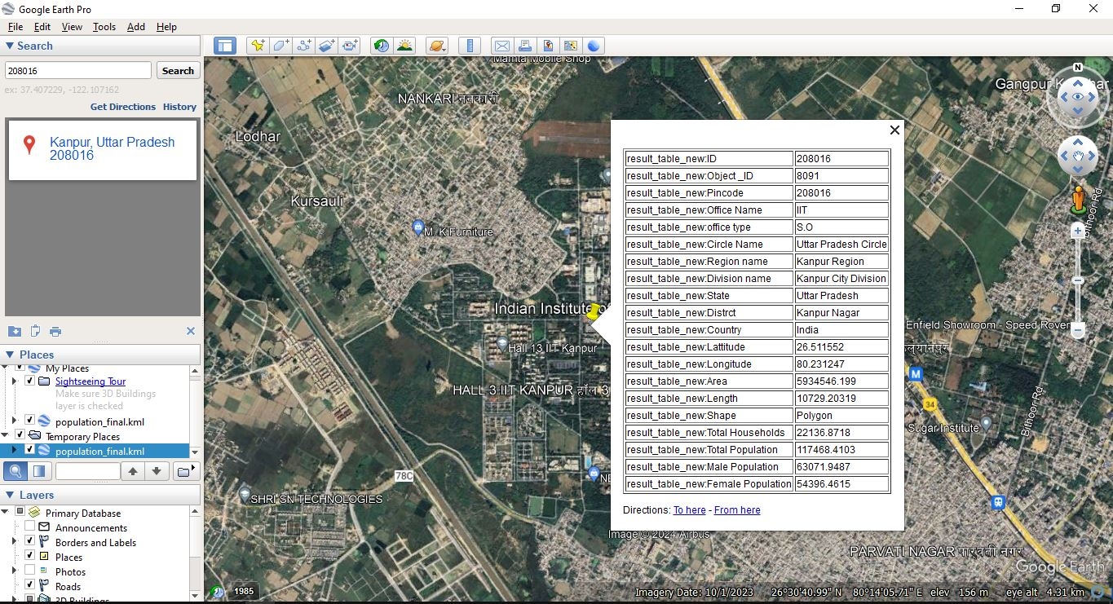
IIT Kanpur - 208016

Slide 16
Application of this Model
Effective way for Governance
Better way of Banking
Better Resource Distribution
Census will be updated
Migration pattern
City Planning would be effective
Policy making

Slide 17
References
Kuria, E., Kimani, S. and Mindila, A., 2019. A framework for web GIS development: a review. International Journal of Computer Applications, 178(16), pp.6-10.
"Census of India.” (n.d.). Census Tables. Retrieved from https://censusindia.gov.in/census.website/data/census-tables"
"Esri. (n.d.). [Pincode Boundary of India 2022]. Retrieved from https://www.arcgis.com/home/item.html?id=e1e9c110611b4e3383a3169901576544"
Esri. (n.d.). Web GIS: Principles and Applications for GIS Web. Retrieved from https://www.esri.com/content/dam/esrisites/en-us/esri-press/pdfs/gtk-web-gis-5e-sample.pdf

Slide 18
Thank You

